Slide 1
Applied Data Science Capstone Project
Selecting the best area to open a new cafe in Düsseldorf

Slide 2

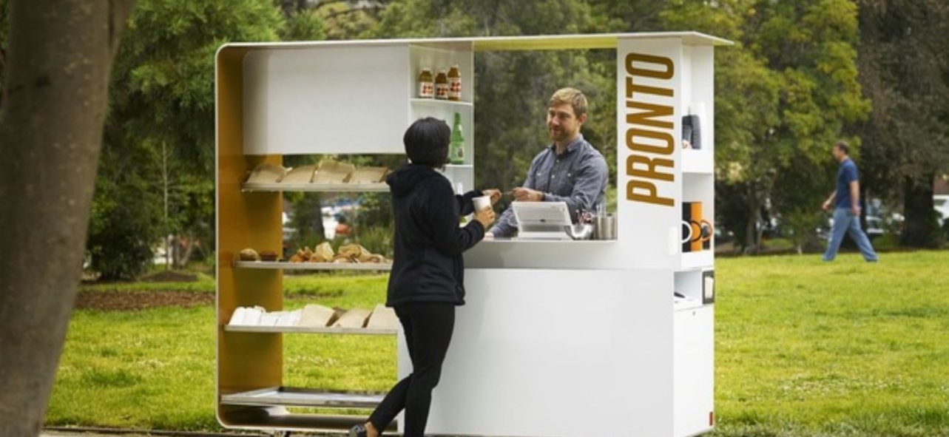
Introduction/Business Problem
I am considering a simple business idea of opening a café in Düsseldorf, Germany.
Though the competition is quite high, this city is growing, and the number of tourists is increasing constantly.
Therefore, the prospect of the stable consumption is optimistic, if the café may stand out.
To resolve this task, I would love to conduct the locations analysis utilizing Foursquare data.
I expect to get data on the existing cafes location, and how they correlate with the areas of offices and shops location. Also, I would love to cluster existing cafes by the range of services they offer.
All this data will be a perfect addition to the field research, and serves as the objective grounding for the decision-making.

Slide 3
Elaboration on the business case
This case may seem as not that complex business one, but what I am trying to achieve here is to understand if the tools and techniques of data science can serve their purpose on the level of small business decision making.
When it comes to the selection of the location for the café in a big city, it seems logical to verify own intuitive assumptions about the location trough the perspective of the objective data analysis – where are competitors concentrated, what do they offer etc.
Therefore, the target audience of the results of this exploratory analysis are not the potential café owners themselves, but also those who can be inspired by the use of similar techniques for the urban planning, small business distribution analysis etc.

Slide 4
Data section
As there in no single list of existing café in Düsseldorf, the major source of data to be utilized is the Foursquare API Endpoints (https://developer.foursquare.com/docs/places-api/endpoints/) to get the list of venues, where the filtering will be made by names (with the key words as “café” in name) and by services – all with the purpose to identify those venues which offer coffee as a separate service,
The same will apply to the offices and shops detection (searching by key elements - Foursquare API Endpoints),
Obtained data is expected to be processes in the way:
Put both café and offices on the map, calculate their numbers in various areas of the city,
Apply k-means clustering in order to detect the most typical services included in the café range,
Apply k-means clustering in order to detect the relevance of the location, services and customers’ feedback,
Align locations data and the most popular services.
As the last step, the expert judgement will be formulated, which area and the service seem to have a potential from the perspective of the current saturation.
Obviously, the data described above, just alone can be considered as a subjective basis for the decision making, and will be complemented by other external factors and considerations.

